Slide 1
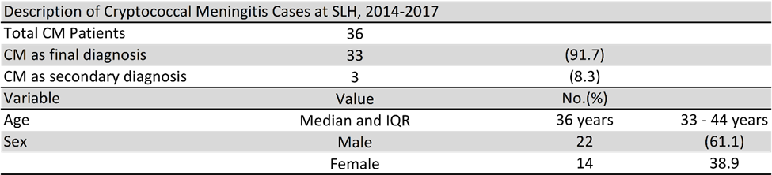
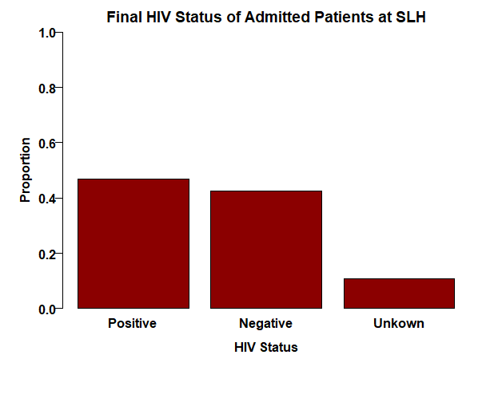
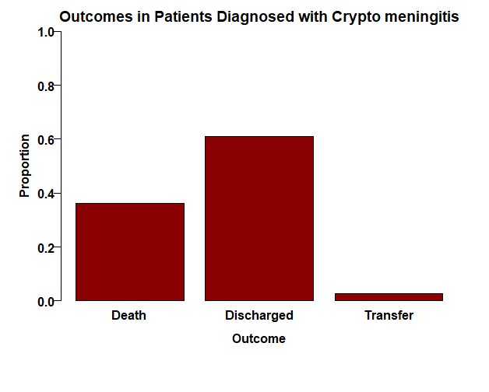
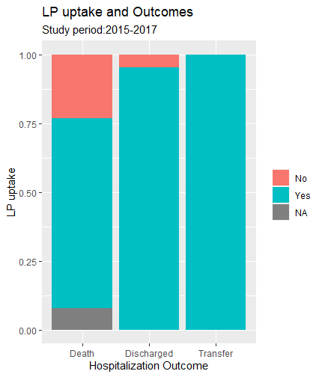
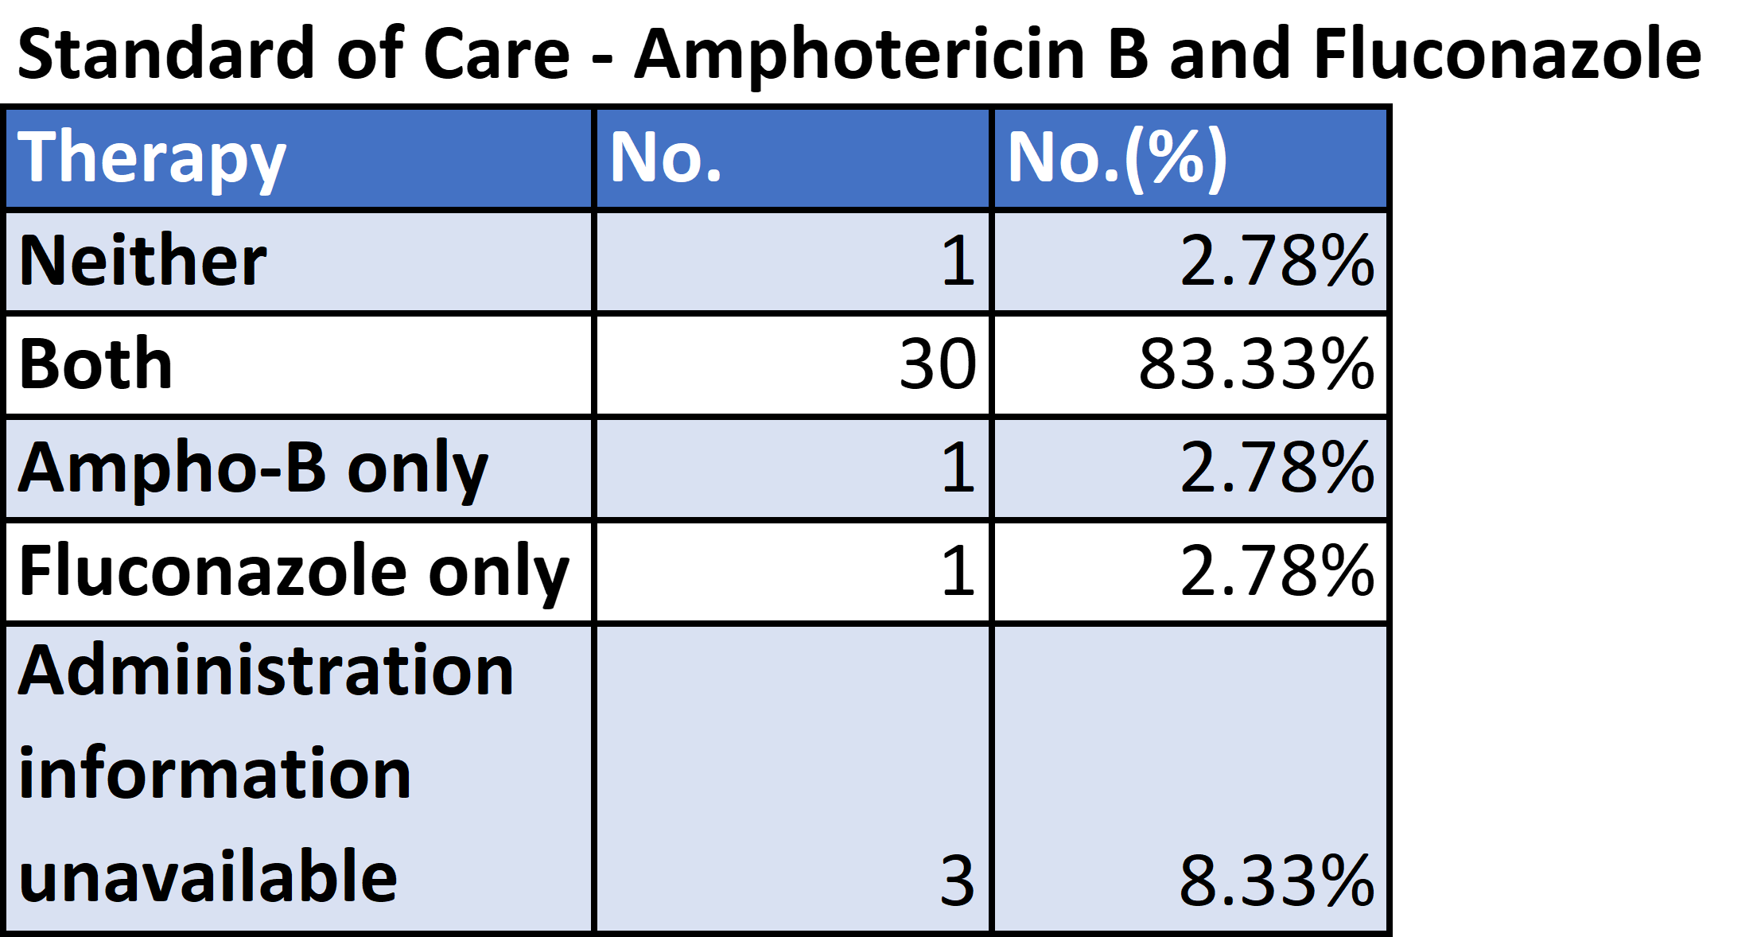

HIV-related Cryptococcal meningitis (CM) at a District-level Hospital in Botswana: Management and Outcomes
Sally Madiba, MSIV¹ and Sara Schwanke Khilji, MD, MPH, FACP²
¹University of California, Davis, ²Botswana-Harvard AIDS Institute Partnership
INTRODUCTION
RESULTS
CONCLUSIONS
Botswana has a very high HIV-prevalence rate (>20%)
75% of HIV-related CM deaths occur in Sub-Saharan Africa
1-year survival rate for CM is 35% in Botswana
HIV is a major risk factor for CM, although the cause of high-incidence of HIV-associated CM is multifactorial
Findings consistent with existing evidence regarding CM prevalence in high HIV-prevalence settings
Higher HIV-prevalence (43%) at SLH
All CM was HIV-related – 55.6% with CD4 <100
Higher observed 2-week mortality rate of 31% (vs 26% in other studies) with overall in-hospital mortality rate of 36%
Most patients were managed in accordance with international guidelines
Newer recommended regimens are not yet available in this setting, but are an important area for future research
22
13
OBJECTIVES
Determine prevalence of HIV-associated CM and associated in-hospital mortality
Assess clinical management of HIV-associated CM with reference to WHO guidelines
1
ACKNOWLEDGEMENTS
Sara Schwanke Khilji, MD, MPH, FACP
Nabila Youssouf, MSc, PhD
UC Davis Health Clinical and Translational Science Center (CTSC) – statistical support
Amy Studer, UC Davis Blaisdell Medical Library
METHODS
Retrospective chart review of CM admissions between 12/2014 and 10/2017
Descriptive summary statistics completed using R software

